Slide 1



Graduate Counselling
IST659 Database Management Studies
-Sharvil Turbadkar

Slide 2
Project Goals
The data that can be collected from this project is as follows ::
Students that are assigned to Counsellors
Counsellors payrate and pay amount over their due tenure of counselling
Counsellor Feedback given by students
Student academic profile based on which the student is getting recommended universities
Which universities are recommended by counsellors to students
Which countries are students pursuing their studies more often

Slide 3

Project Goals
Who can input data
Students
Counsellors
Teachers
Admin Department
Who can Query data
Admin Department(For Recommendation Purposes)
Students
Counsellors

Slide 4
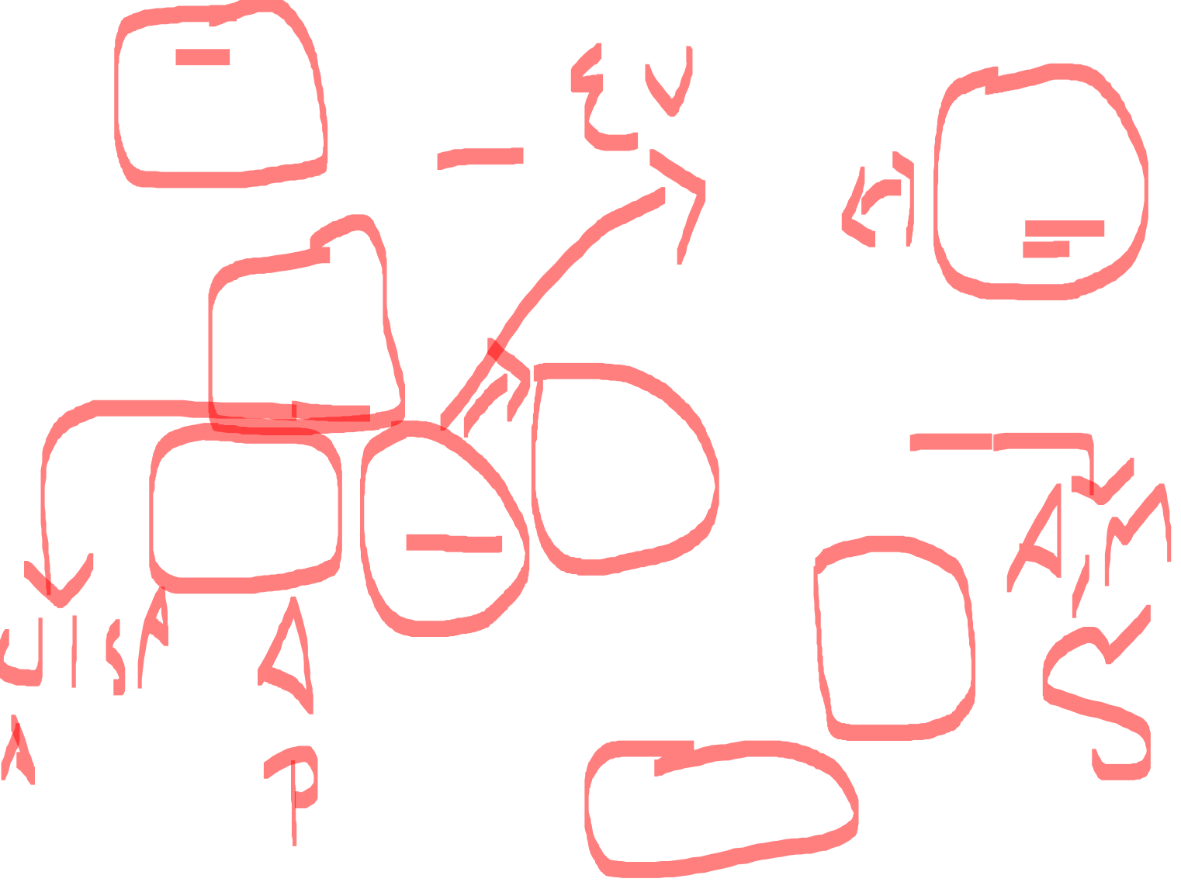
ER Diagram -Visio

Slide 5
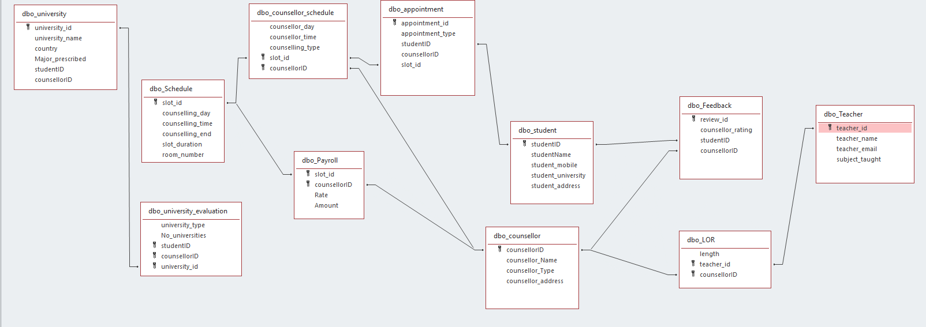
ER Access Diagram

Slide 6


Form 1:Student Academic Report

Slide 7
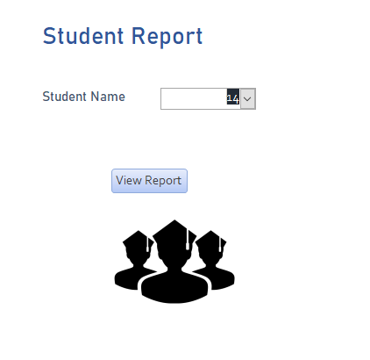

Enter Student ID to View Report

Slide 8
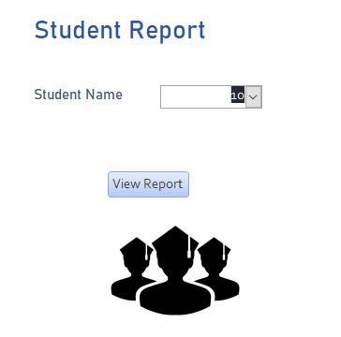
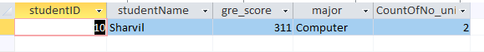

After Entering Student ID Student Report is Generated

Slide 9
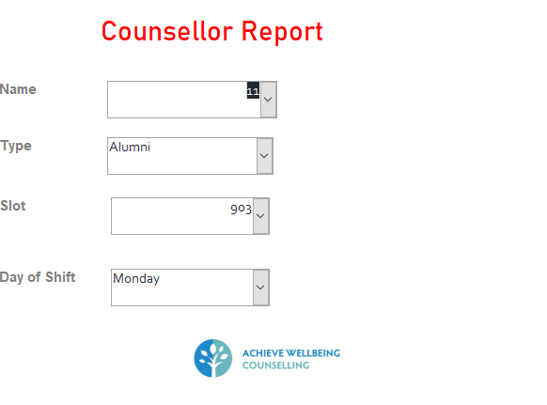

Form 3-Counsellor report

Slide 10
Major Data Questions
Which Counsellors earn the most ?
How does every counsellor fare in their services (Feedback)?
Students seek which counselling help more often
Which country is the most preferred for pursuing further education
Which countries are hotbeds for which subjects?
Which counsellors are the busiest?
How many universities do students apply to?
Which teachers get recommended more for LOR’s
How many Students have enrolled

Slide 11
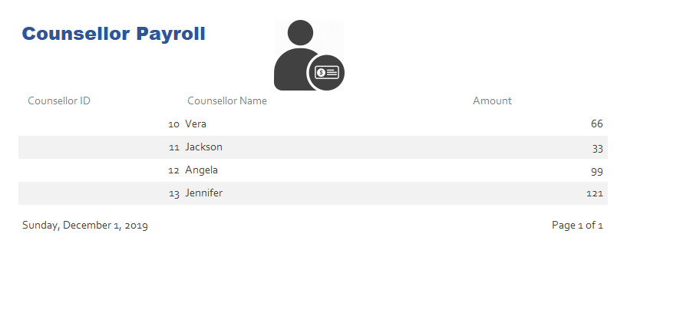

Which Counsellors earn the most ?

Slide 12
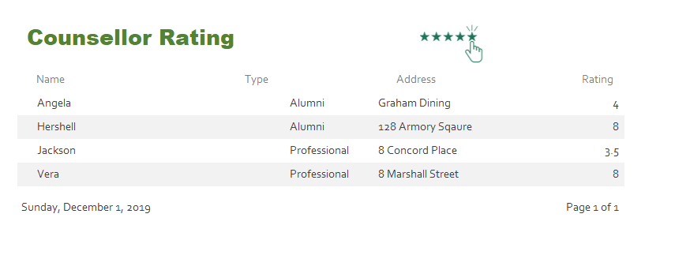

How does every counsellor fare in their services (Feedback)?

Slide 13
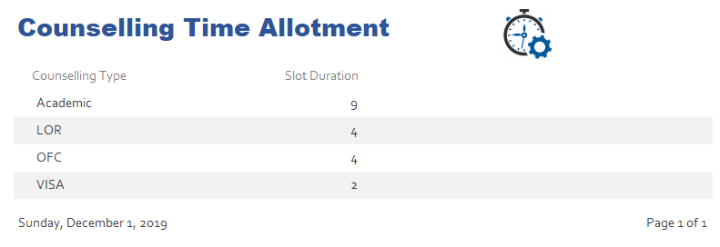

Students seek which counselling help more often

Slide 14
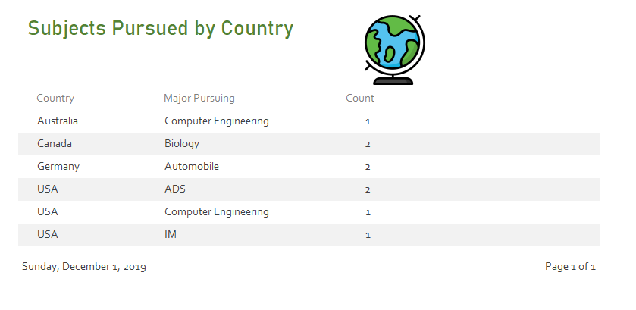

Which countries are hotbeds for which subjects?

Slide 15
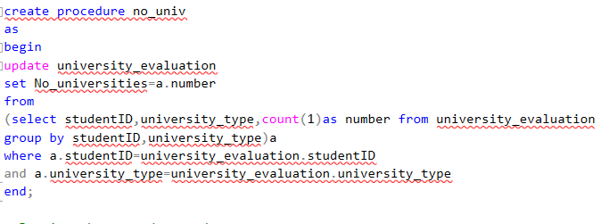
Stored Procedure: To capture how many universities are students applying to by their type

Slide 16
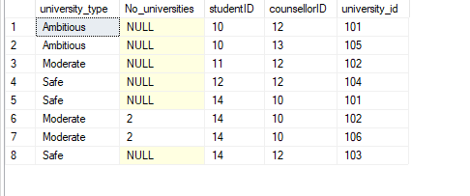
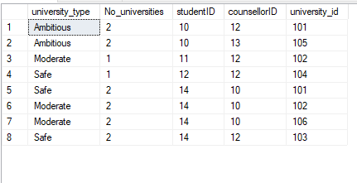

Before
After

Slide 17
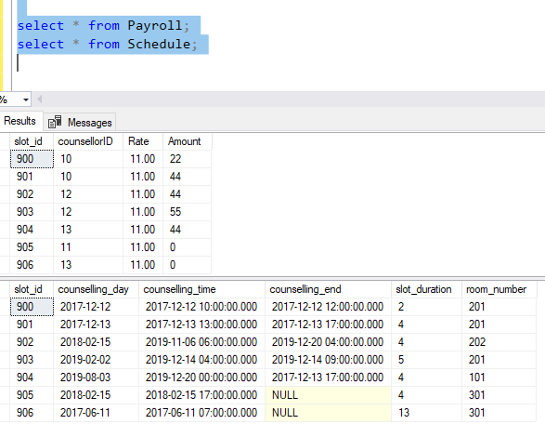

Trigger to update Counselling time and Payroll of Counsellors
Before Trigger

Slide 18
Purpose of the Trigger is to update Counselling Session time for other counsellors and students to book slots
The Trigger also updates Payroll of the counsellors for counsellors to query and view their total pay

Slide 19
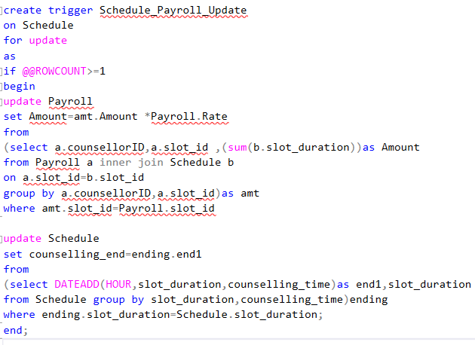
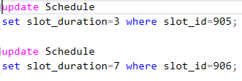
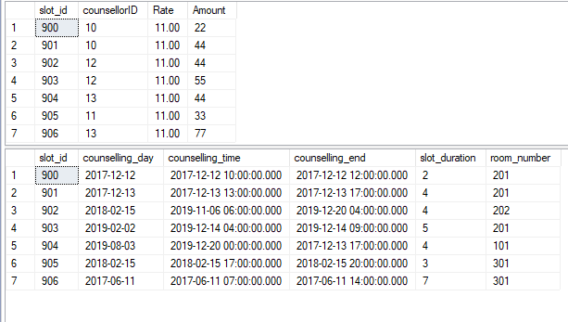

Trigger
Output After trigger

Slide 20
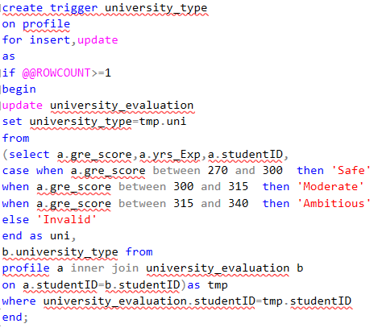
Trigger to Assign Universities to Students

Slide 21
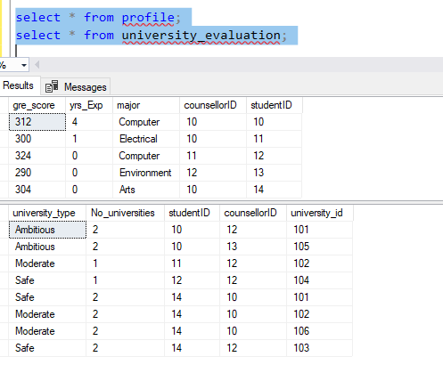
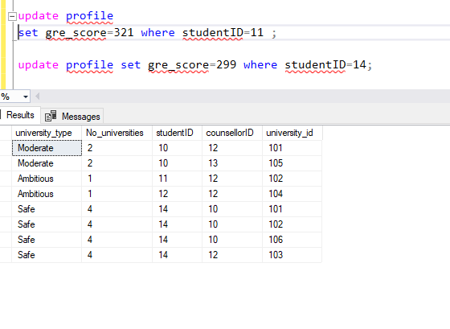

Before
After

Slide 22

Thank You

